Slide 1
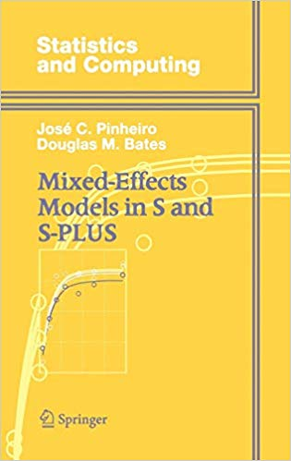
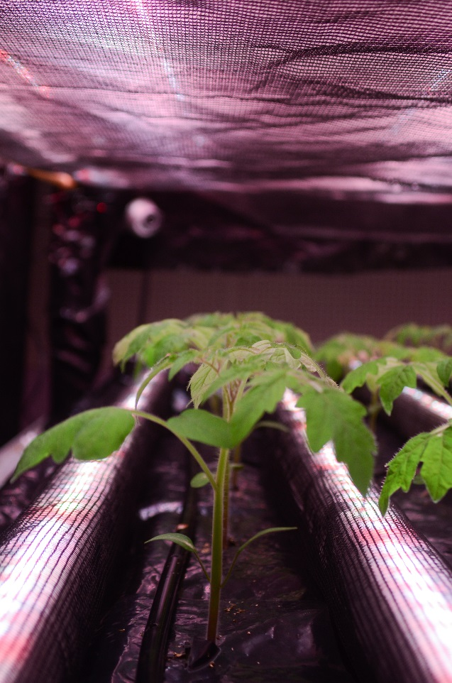
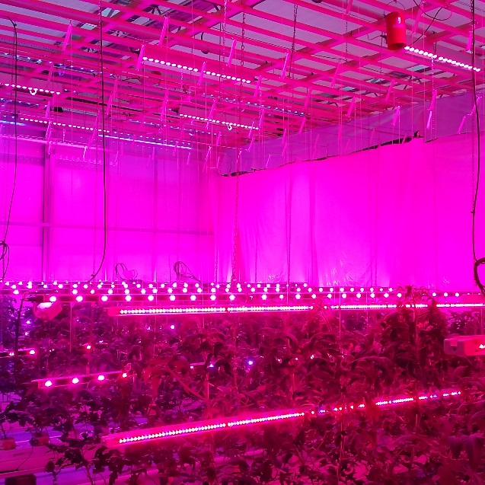
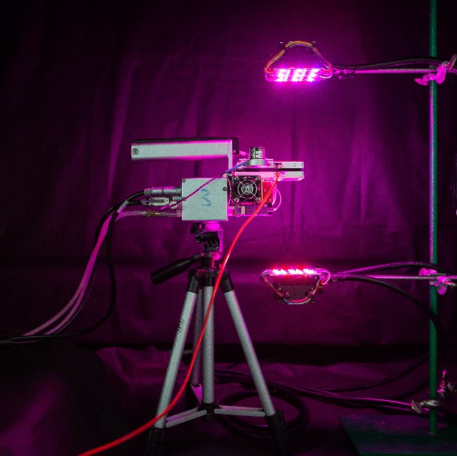
Colloquium MSc student
Stephen Coleman
Gerrit Gort
Elias Kaiser
Rachel Schipper
Anne Elings
Notes:
My name is Rachel Schipper, and I would like to tell you a story with 2 sides. It the a story about light and leaves, both driving factors behinds plant growth. Nowadays, we give a lot of extra light to our plants in greenhouses. But are we really doing this right?

Slide 2
Initial project
Describe photosynthetic parameters using non-linear mixed effects models.
Inspired by Qian et al. [1]
Use the Farquhar-van Caemmerer–Berry (FvCB) model.
Build an R package to handle this problem.

Slide 3
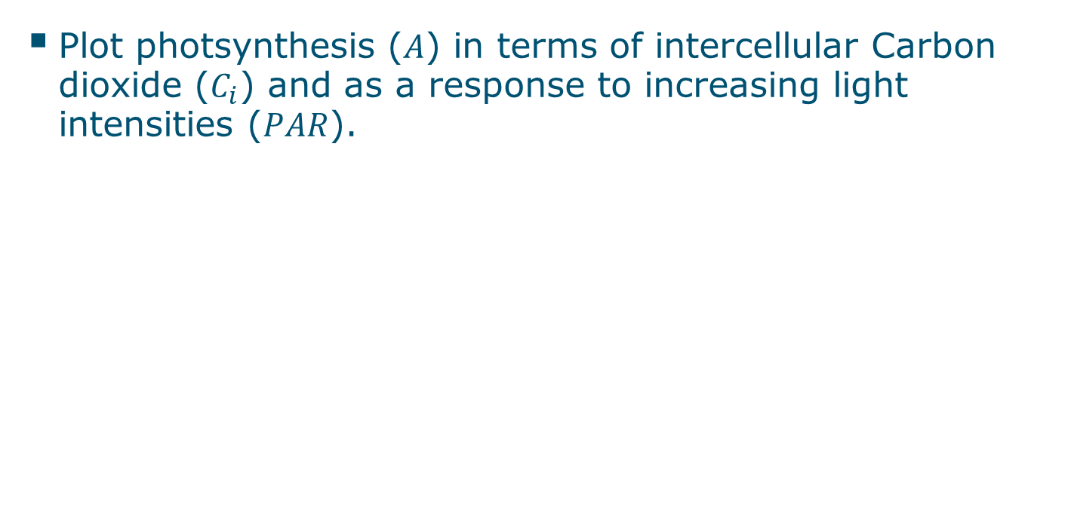
ACI and Light Response curves
Plot photsynthesis ($A$) in terms of intercellular Carbon dioxide ($C_{i}$) and as a response to increasing light intensities ($PAR$).

Slide 4
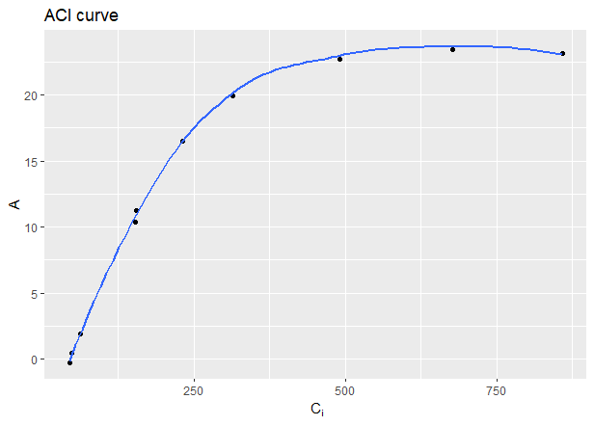
ACI curve

Slide 5
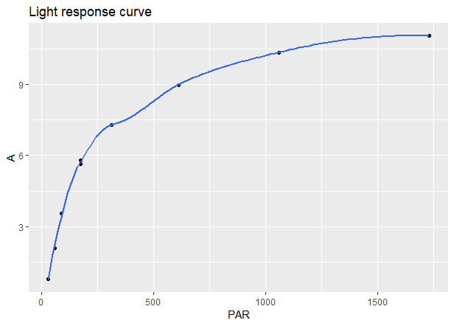
Light response curve

Slide 6
Plots
Both the ACI plot and LRC plot depict asymptotic behaviour.
This is used in the model to describe these curves.

Slide 7
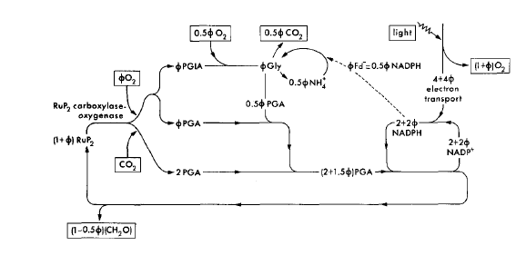
FvCB
Initially described in 1980 [2], the FvCB model is a steady state model describing photosynthesis.
This is the “simplified photosynthetic carbon reduction and photorespiratory cycles” (from [2]).
Rubisco
Electron transport

Slide 8
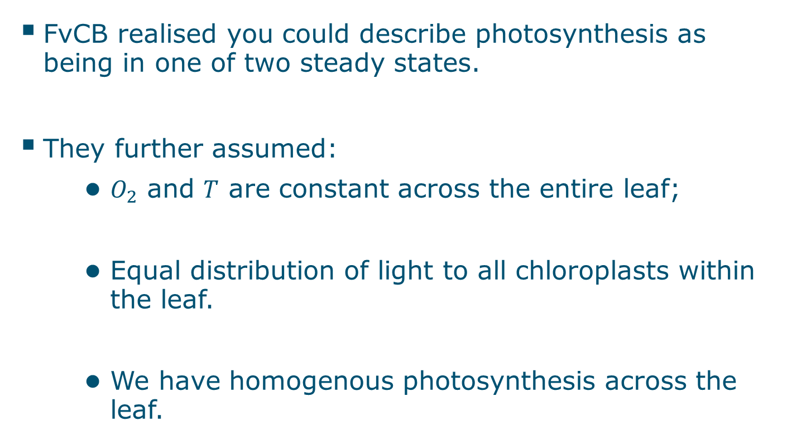
FvCB (ii)
FvCB realised you could describe photosynthesis as being in one of two steady states.
They further assumed:
$O_{2}$ and $T$ are constant across the entire leaf;
Equal distribution of light to all chloroplasts within the leaf.
We have homogenous photosynthesis across the leaf.
Notes:
Ac = Rubisco activity limited net photosynthesis
Aj = Electron transport rate limited net photosynthesis

Slide 9
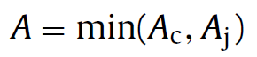
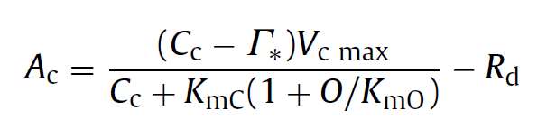
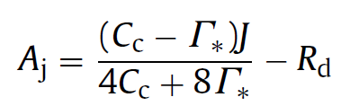
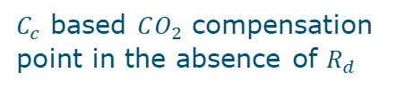

FvCB (iii)
These realisations and assumptions are described in the FvCB model:
Where:
Maximum rate of Rubisco activity-limited carboxylation
$C_{c}$ based $CO_{2}$ compensation point in the absence of $R_{d}$
Electron transport rate through PSII
Michaelis-Menten constant of Rubisco for $CO_{2}, O_{2}$
Daytime respiration
Notes:
Ac = Rubisco activity limited net photosynthesis
Aj = Electron transport rate limited net photosynthesis

Slide 10
FvCB (iv)
How many parameters do we have to estimate?

Slide 11
FvCB (vi)
5 different parameters.

Slide 12
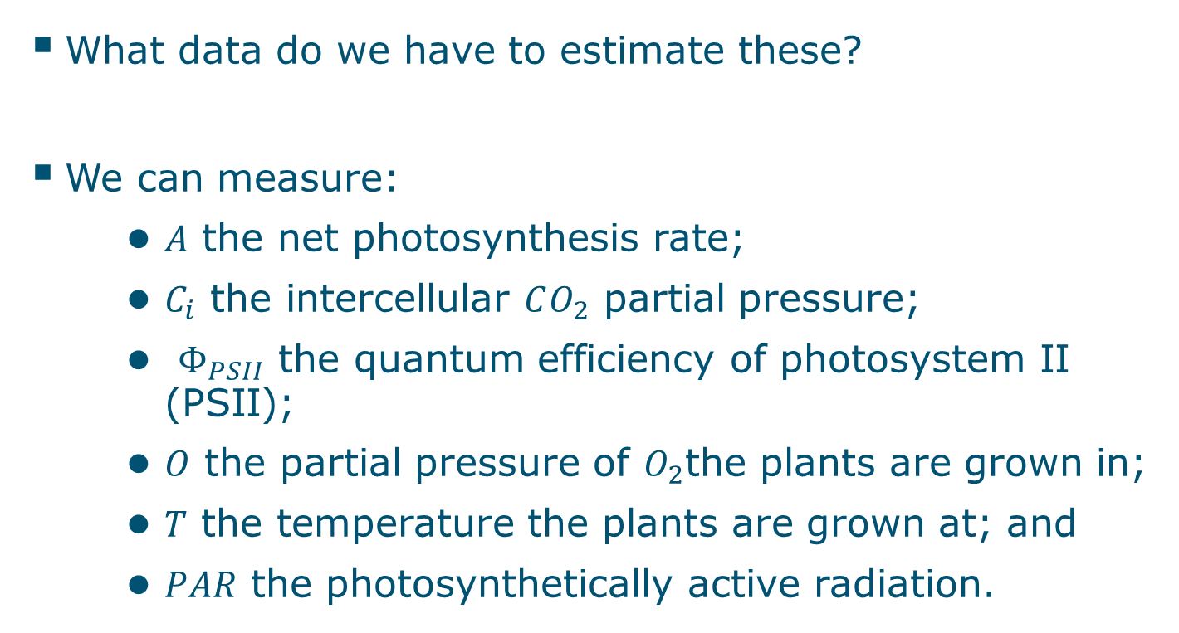
Data
What data do we have to estimate these?
We can measure:
$A$ the net photosynthesis rate;
$C_{i}$ the intercellular $CO_{2}$ partial pressure;
$Φ_{PSII}$ the quantum efficiency of photosystem II (PSII);
$O$ the partial pressure of $O_{2}$the plants are grown in;
$T$ the temperature the plants are grown at; and
$PAR$ the photosynthetically active radiation.

Slide 13
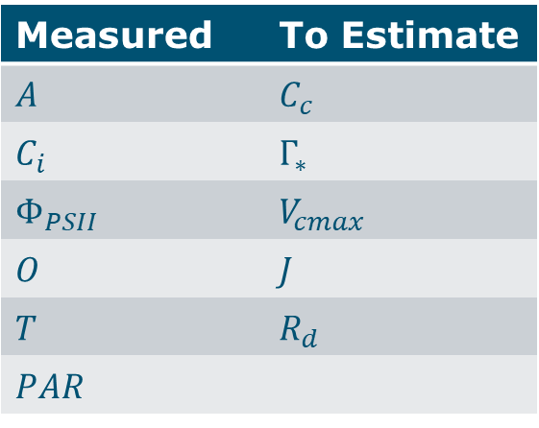
Initial position
We have a number of measurements.
Most are not in our final model.
How to get there?
Measured | To Estimate
𝐴 | $C_{c}$
$C_{i}$ | $Γ_{∗}$
$Φ_{PSII}$ | $V_{cmax}$
𝑂 | $J$
𝑇 | $R_{d}$
𝑃𝐴𝑅

Slide 14
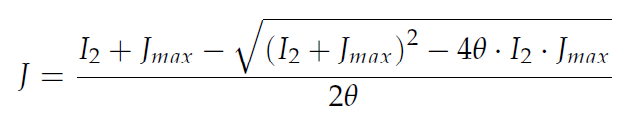
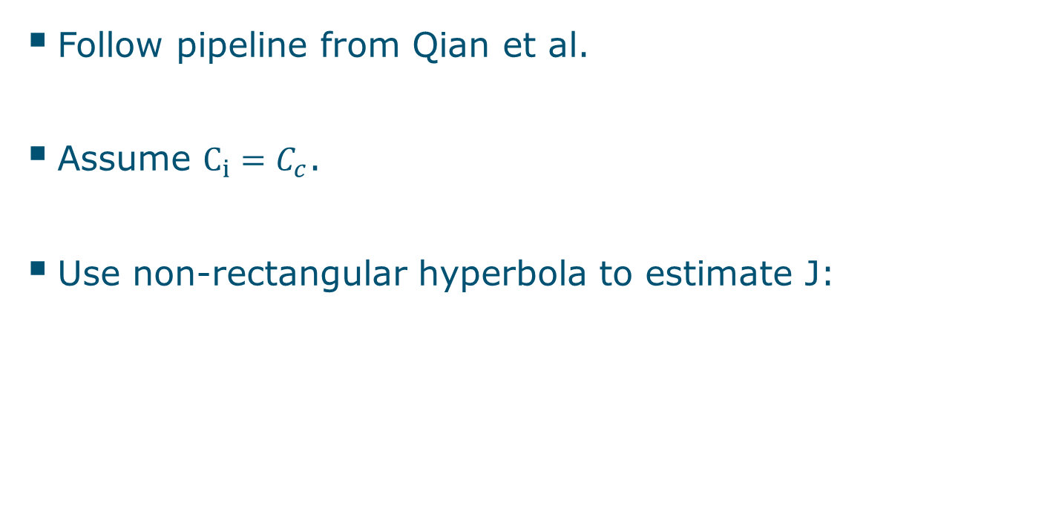
Attempt 1
Follow pipeline from Qian et al.
Assume $C_{i}=C_{c}$.
Use non-rectangular hyperbola to estimate J:

Slide 15
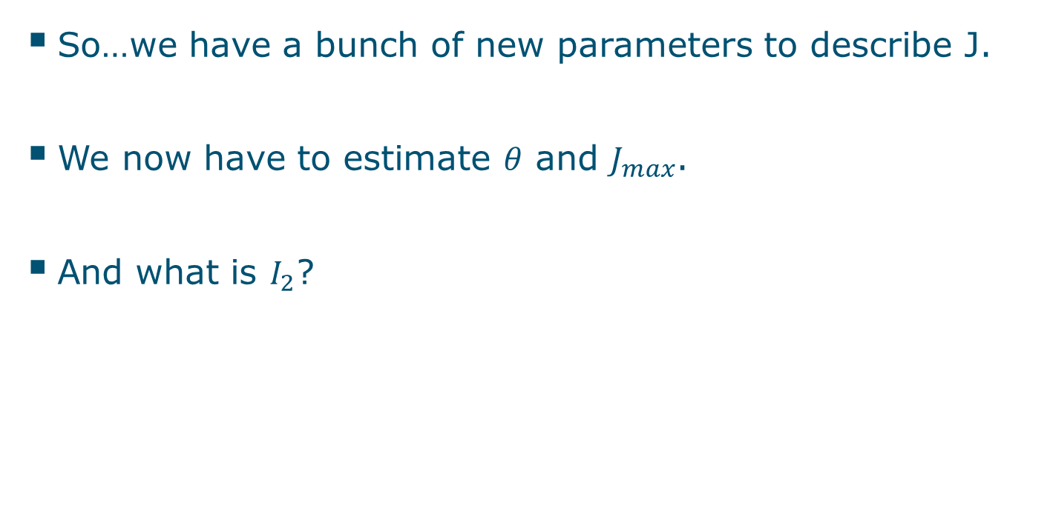
Attempt 1 (ii)
So…we have a bunch of new parameters to describe J.
We now have to estimate $θ$ and $J_{max}$.
And what is $I_{2}$?

Slide 16
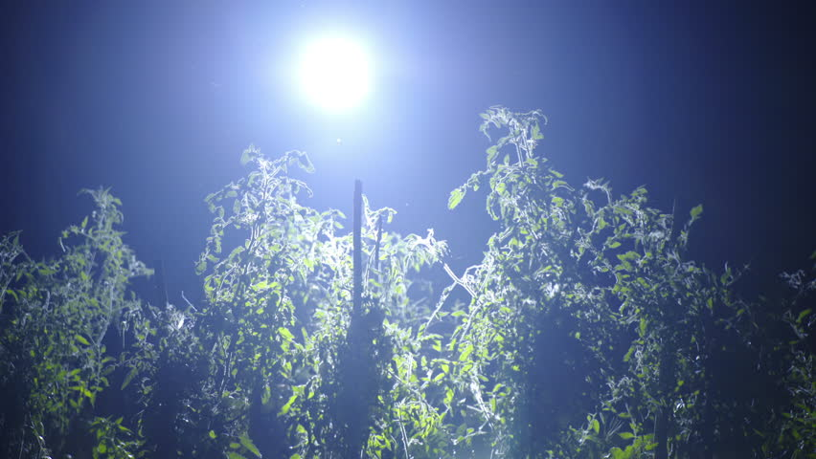
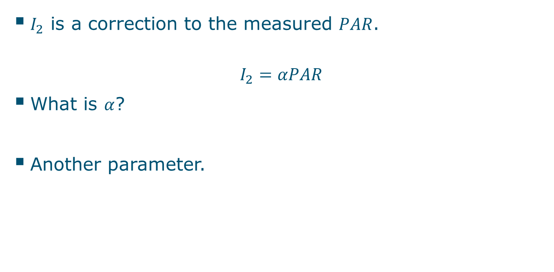
Attempt 1 (iii)
$I_{2}$ is a correction to the measured $PAR$.
$$I_{2}=αPAR$$
What is $α$?
Another parameter.

Slide 17
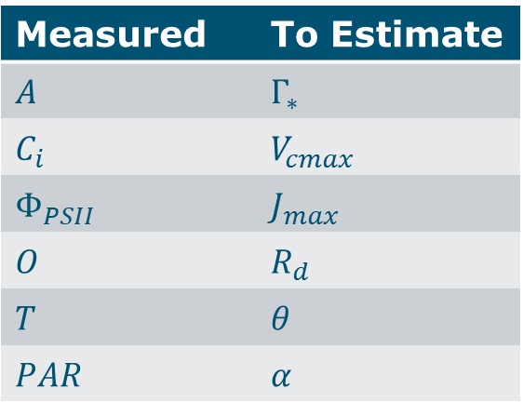
Attempt 1 (iv)
Measured | To Estimate
𝐴 | $Γ_{∗}$
$C_{i}$ | $V_{cmax}$
$Φ_{PSII}$ | $J_{max}$
𝑂 | $R_{d}$
𝑇 | $$θ$$
𝑃𝐴𝑅 | $$α$$

Slide 18
Attempt 1 (v)
Combine data for a light response curve (LRC) with data for an ACI curve.
Use NLME in R with FvCB as the input function.
Estimate parameters.

Slide 19
Attempt 1 (vi)
This works with Qian’s datasets trying different starting values for our 6 parameters and different control values and covariance structures.
Problem:
How to generalise this to a package?

Slide 20


Interlude on packages
Rstudio is a great environment for this.
Hadley Wickham has a really nice book on how to go about constructing a package.

Slide 21
Attempt 1 (vii)
Finding starting values in the literature that should work was difficult.
It revealed that the field of plant physiology is by no means unanimous on how photosynthesis should be modelled.
Furthermore, Qian’s data was not representative of modern datasets.

Slide 22
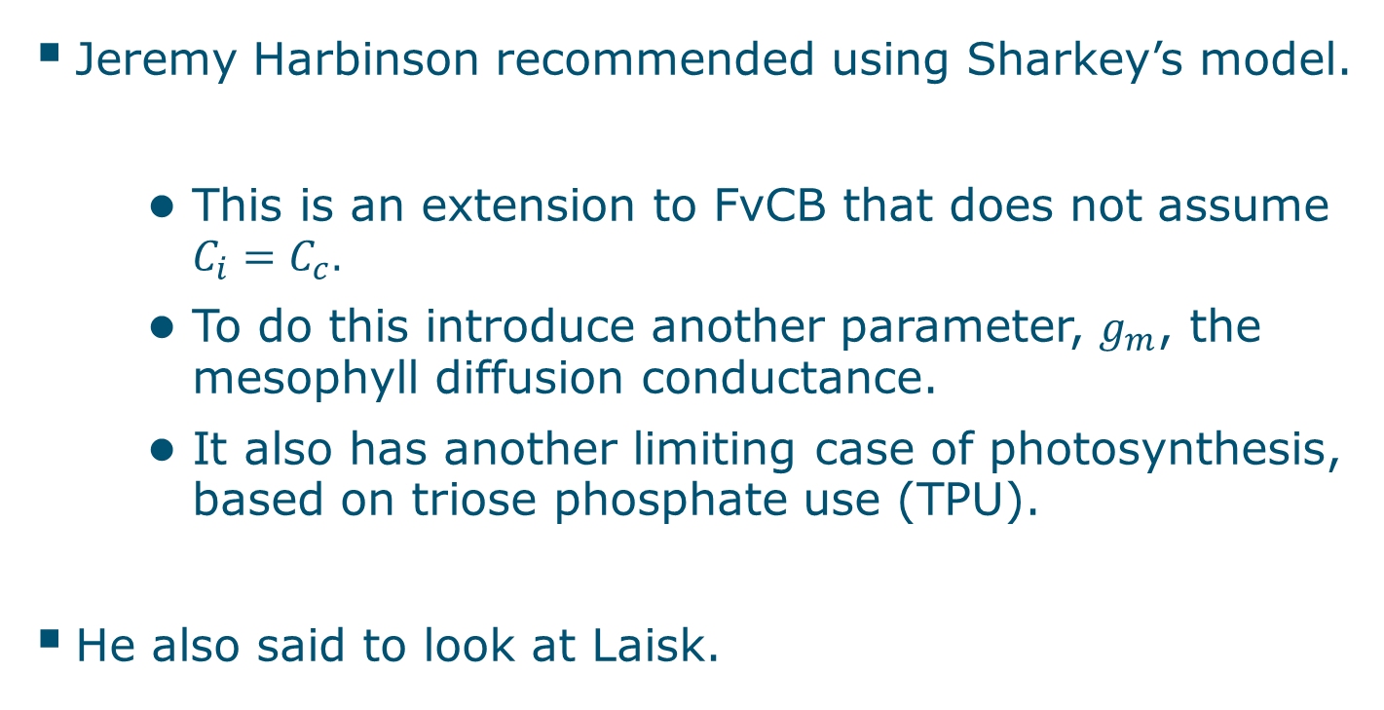
Call in the marines
Jeremy Harbinson recommended using Sharkey’s model.
This is an extension to FvCB that does not assume $C_{i}=C_{c}.$
To do this introduce another parameter, $g_{m}$, the mesophyll diffusion conductance.
It also has another limiting case of photosynthesis, based on triose phosphate use (TPU).
He also said to look at Laisk.

Slide 23
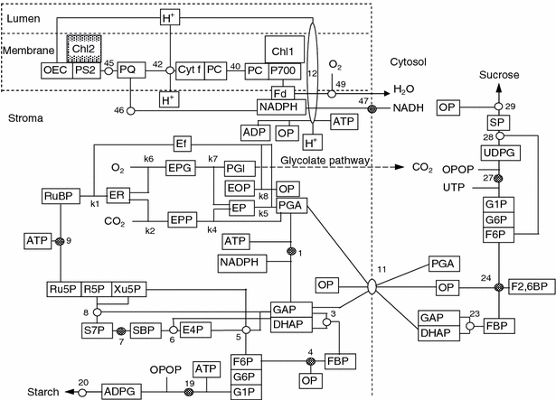
Laisk
C3 photosynthesis according to Laisk

Slide 24
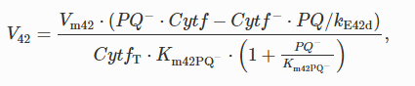
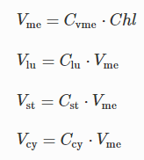
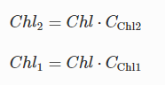
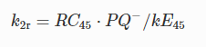
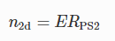
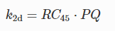
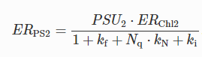
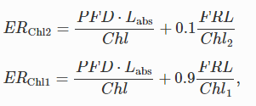
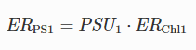
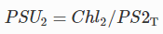
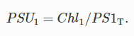
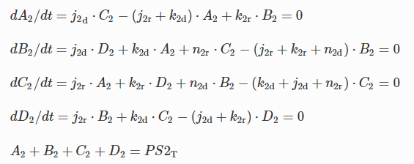
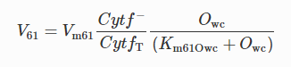
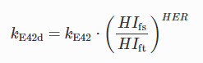
Laisk (ii)

Slide 25
Laisk (iii)
Highly theoretical.
Parameters that cannot be estimated or measured yet.

Slide 26
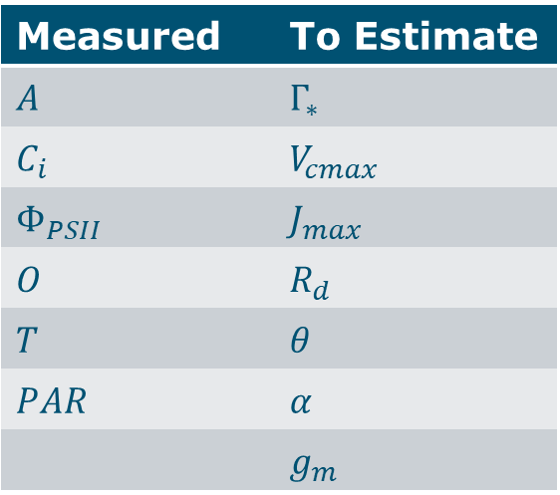
Lasik (iv)
Back to FvCB.
Now using Sharkey’s extension.
Additional parameter to estimate.
Measured | To Estimate
𝐴 | $Γ_{∗}$
$C_{i}$ | $V_{cmax}$
$Φ_{PSII}$ | $J_{max}$
𝑂 | $R_{d}$
𝑇 | $$θ$$
𝑃𝐴𝑅 | $$α$$
 | $$g_{m}$$

Slide 27
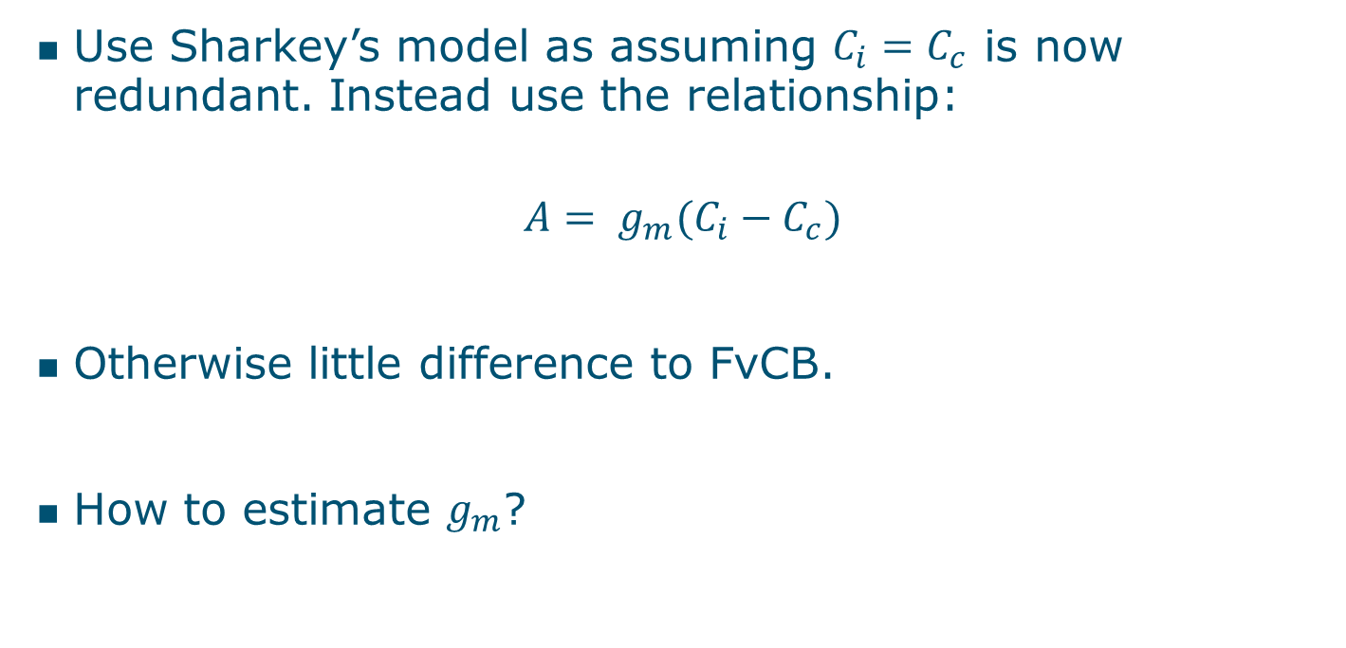
Attempt 2
Use Sharkey’s model as assuming $C_{i}=C_{c}$ is now redundant. Instead use the relationship:
$$A= g_{m}(C_{i}−C_{c})$$
Otherwise little difference to FvCB.
How to estimate $g_{m}$?

Slide 28
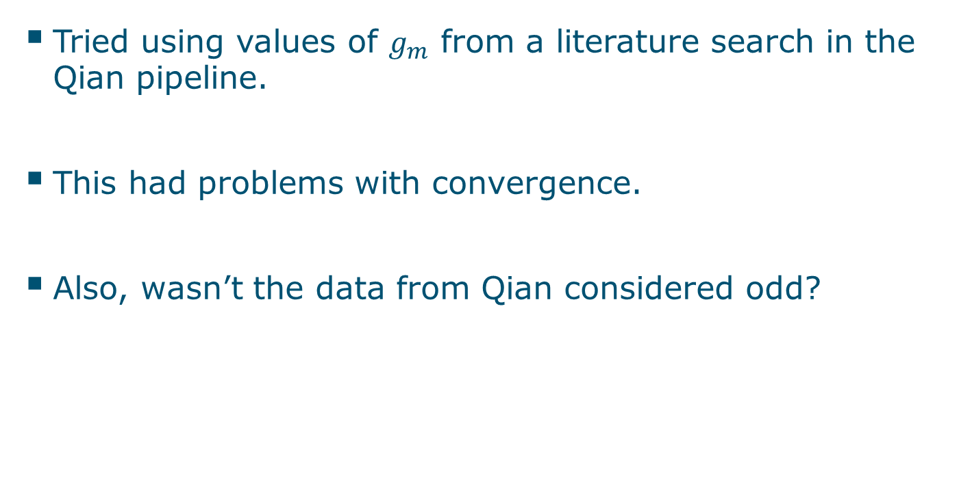
Attempt 2 (ii)
Tried using values of $g_{m}$ from a literature search in the Qian pipeline.
This had problems with convergence.
Also, wasn’t the data from Qian considered odd?

Slide 29
Data problems
We needed a new dataset:
Representative of modern datasets; and
With sufficient datapoints to fit a non-linear mixed effects model.
Rachel Schipper appeared and offered us her data.

Slide 30
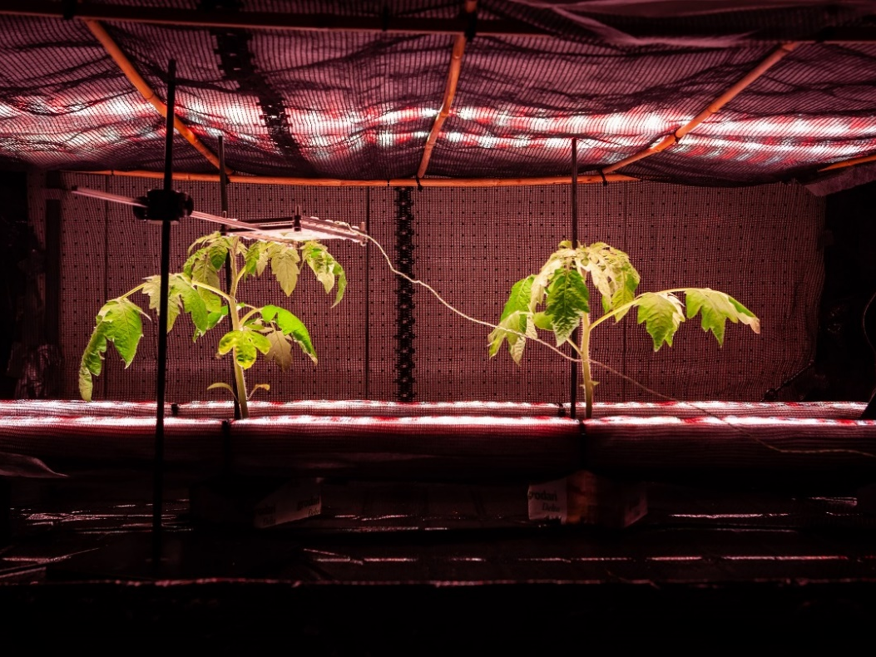
Outline
Two-sided photosynthesis experiment
Data is from Rachel Schipper, a PhD student.
Experiment focused on plants growing under two treatments (A1, A2).
Measurements were taken for each plant from different sides (AD, AB).

Slide 31
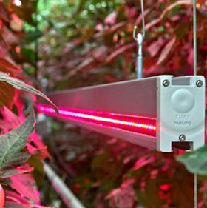
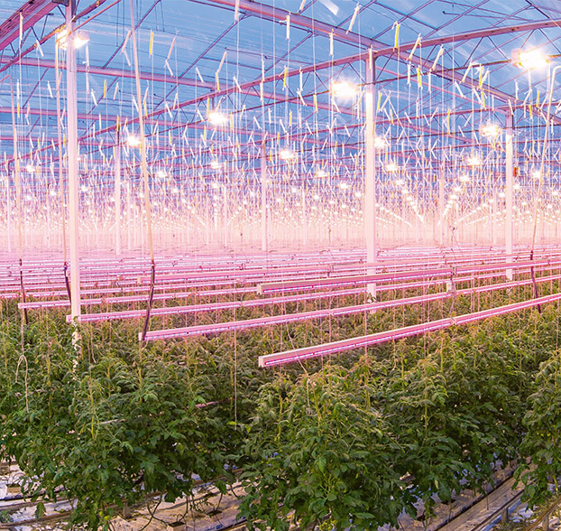
Interlighting – what’s the consequence?

Slide 32
Smart LED lighting strategies
Top lighting system
Top + interlighting system
Notes:
To increase absorption of light, we need to create a more homogenous gradient of light through the canopy. Interlighting can help achieving this, by having an light source inside the canopy.
When leaves are illuminated not only from the top, but also from the side, the proportion of light received by the lower side of the leaf, increases.

Slide 33
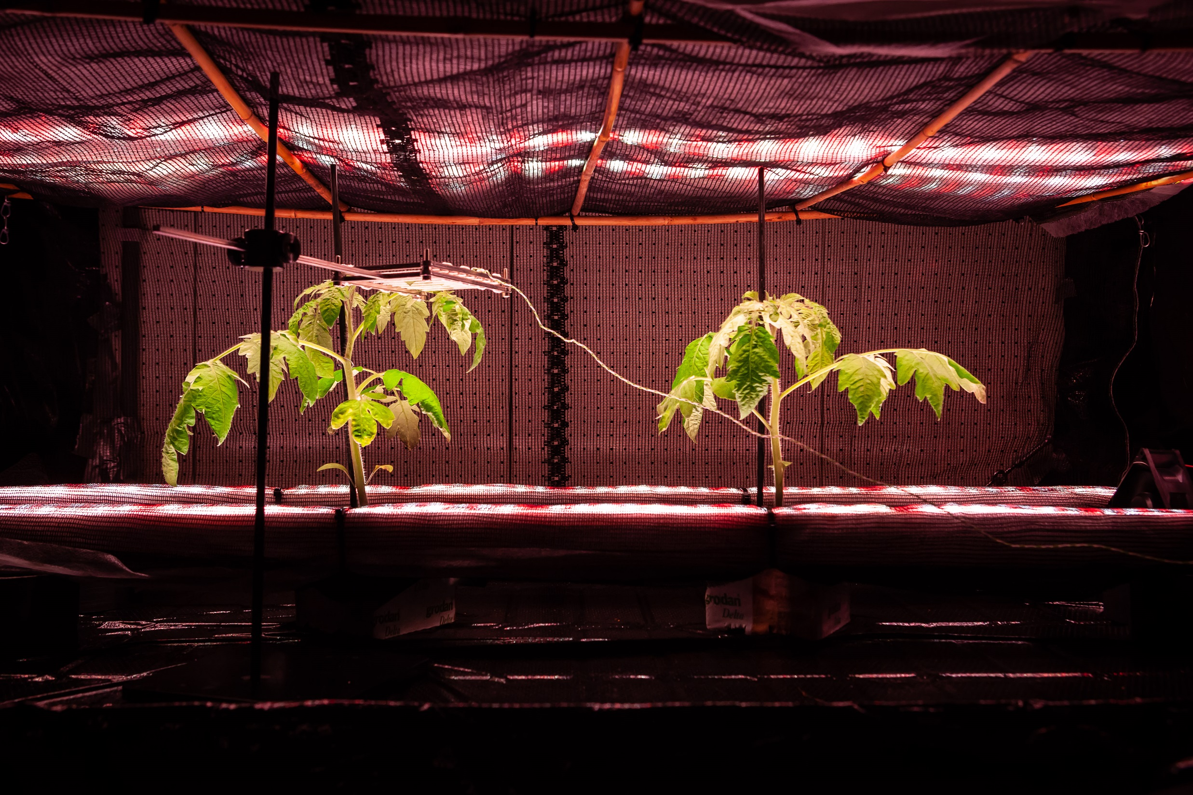
Light coming from above and below

Slide 34
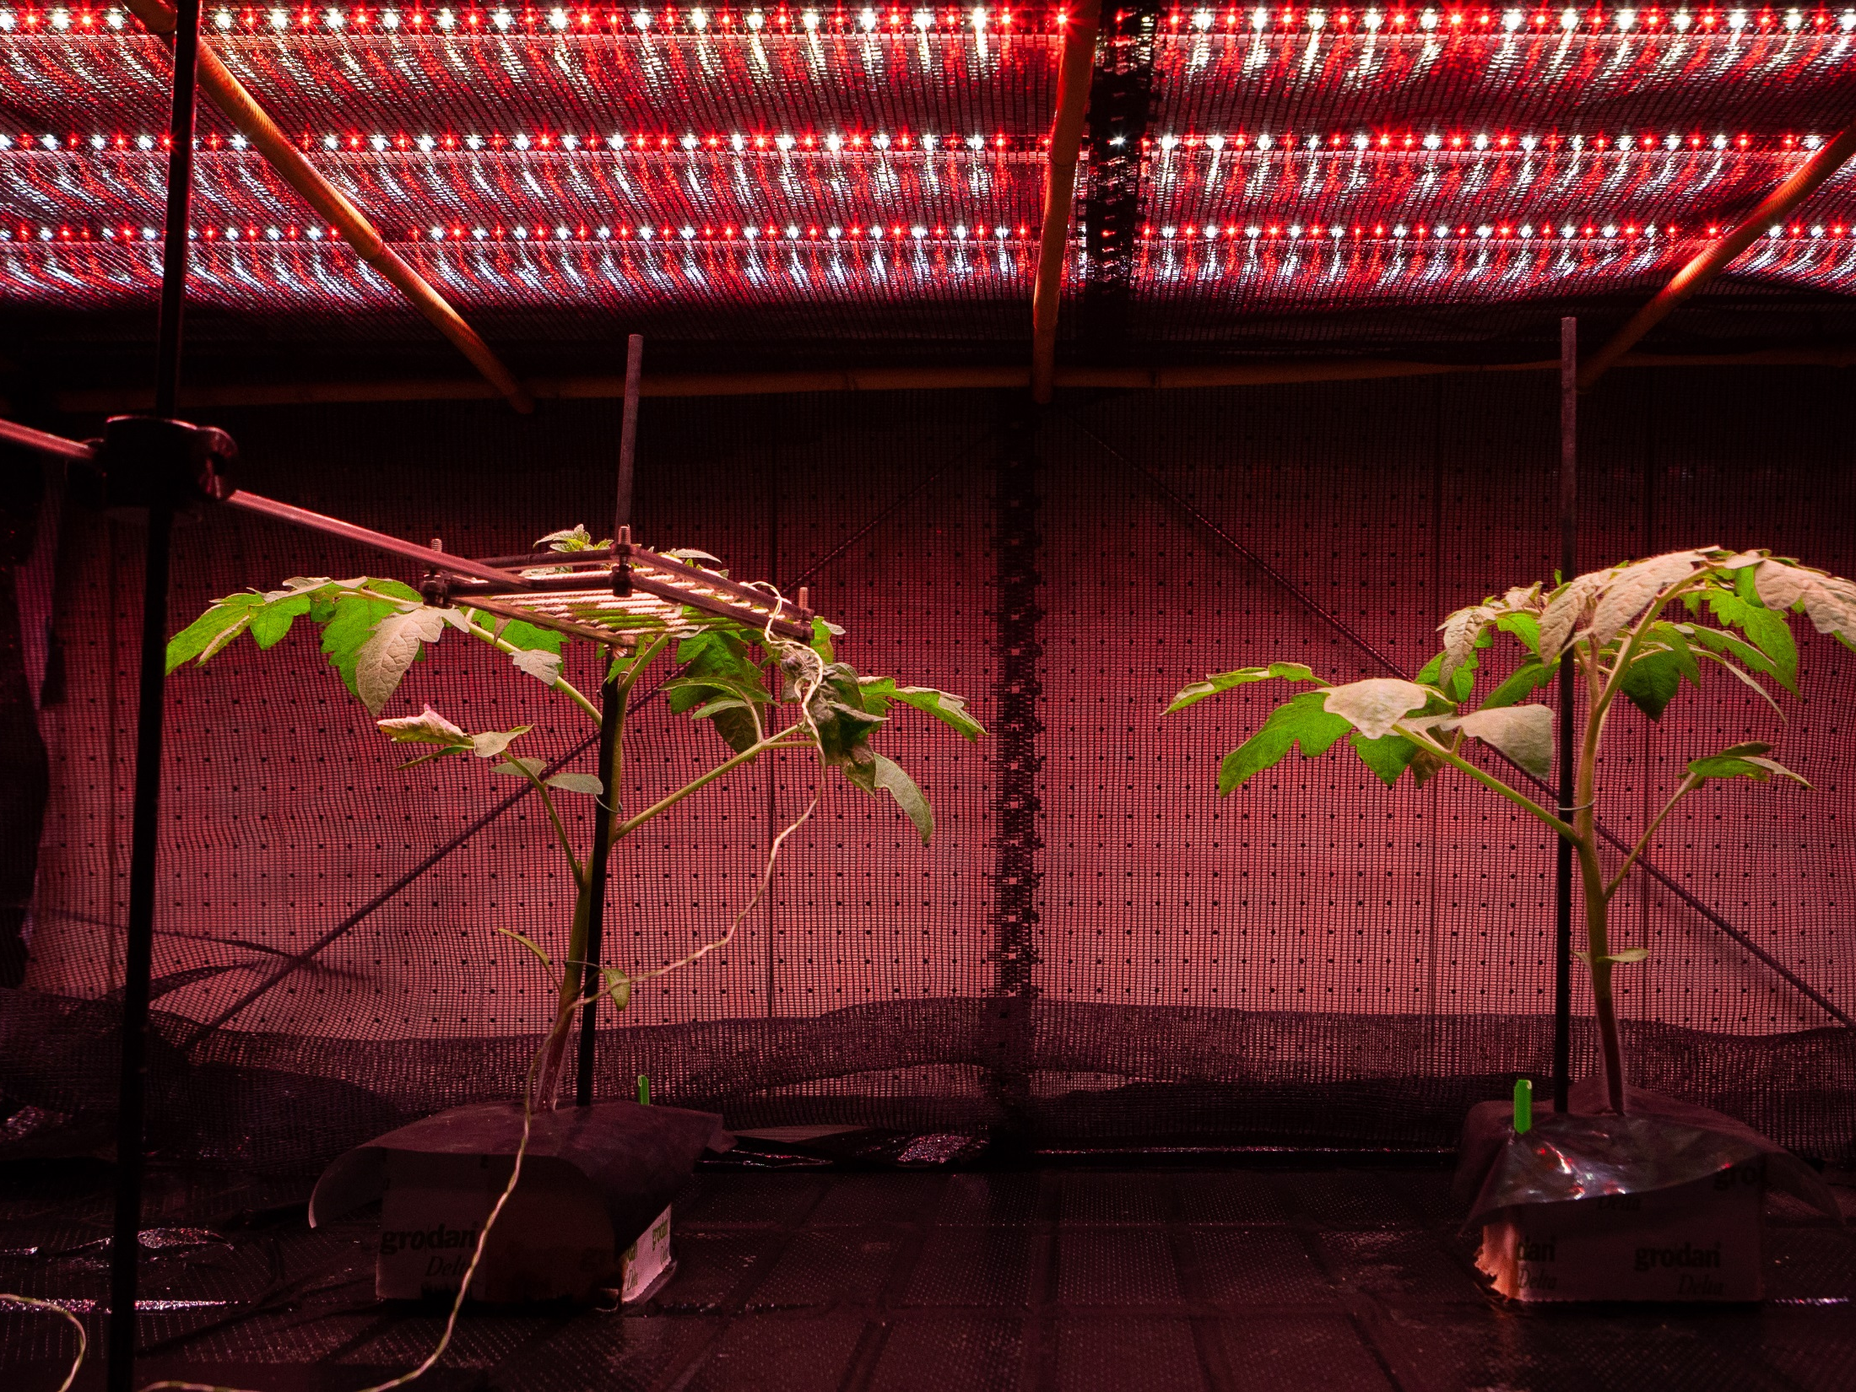
Light coming from above only

Slide 35
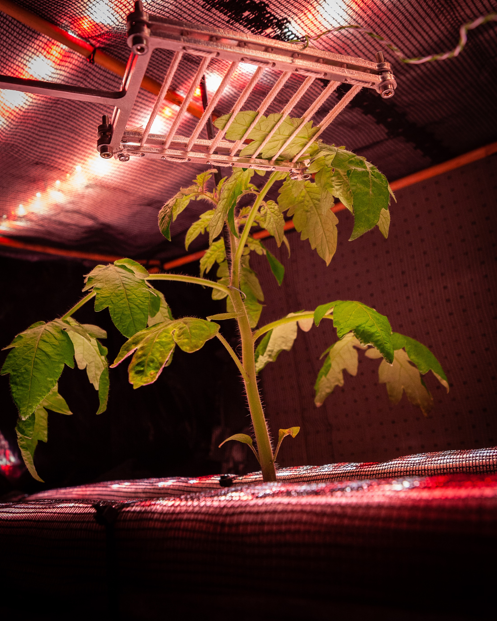
Leaf stabiliser in action

Slide 36
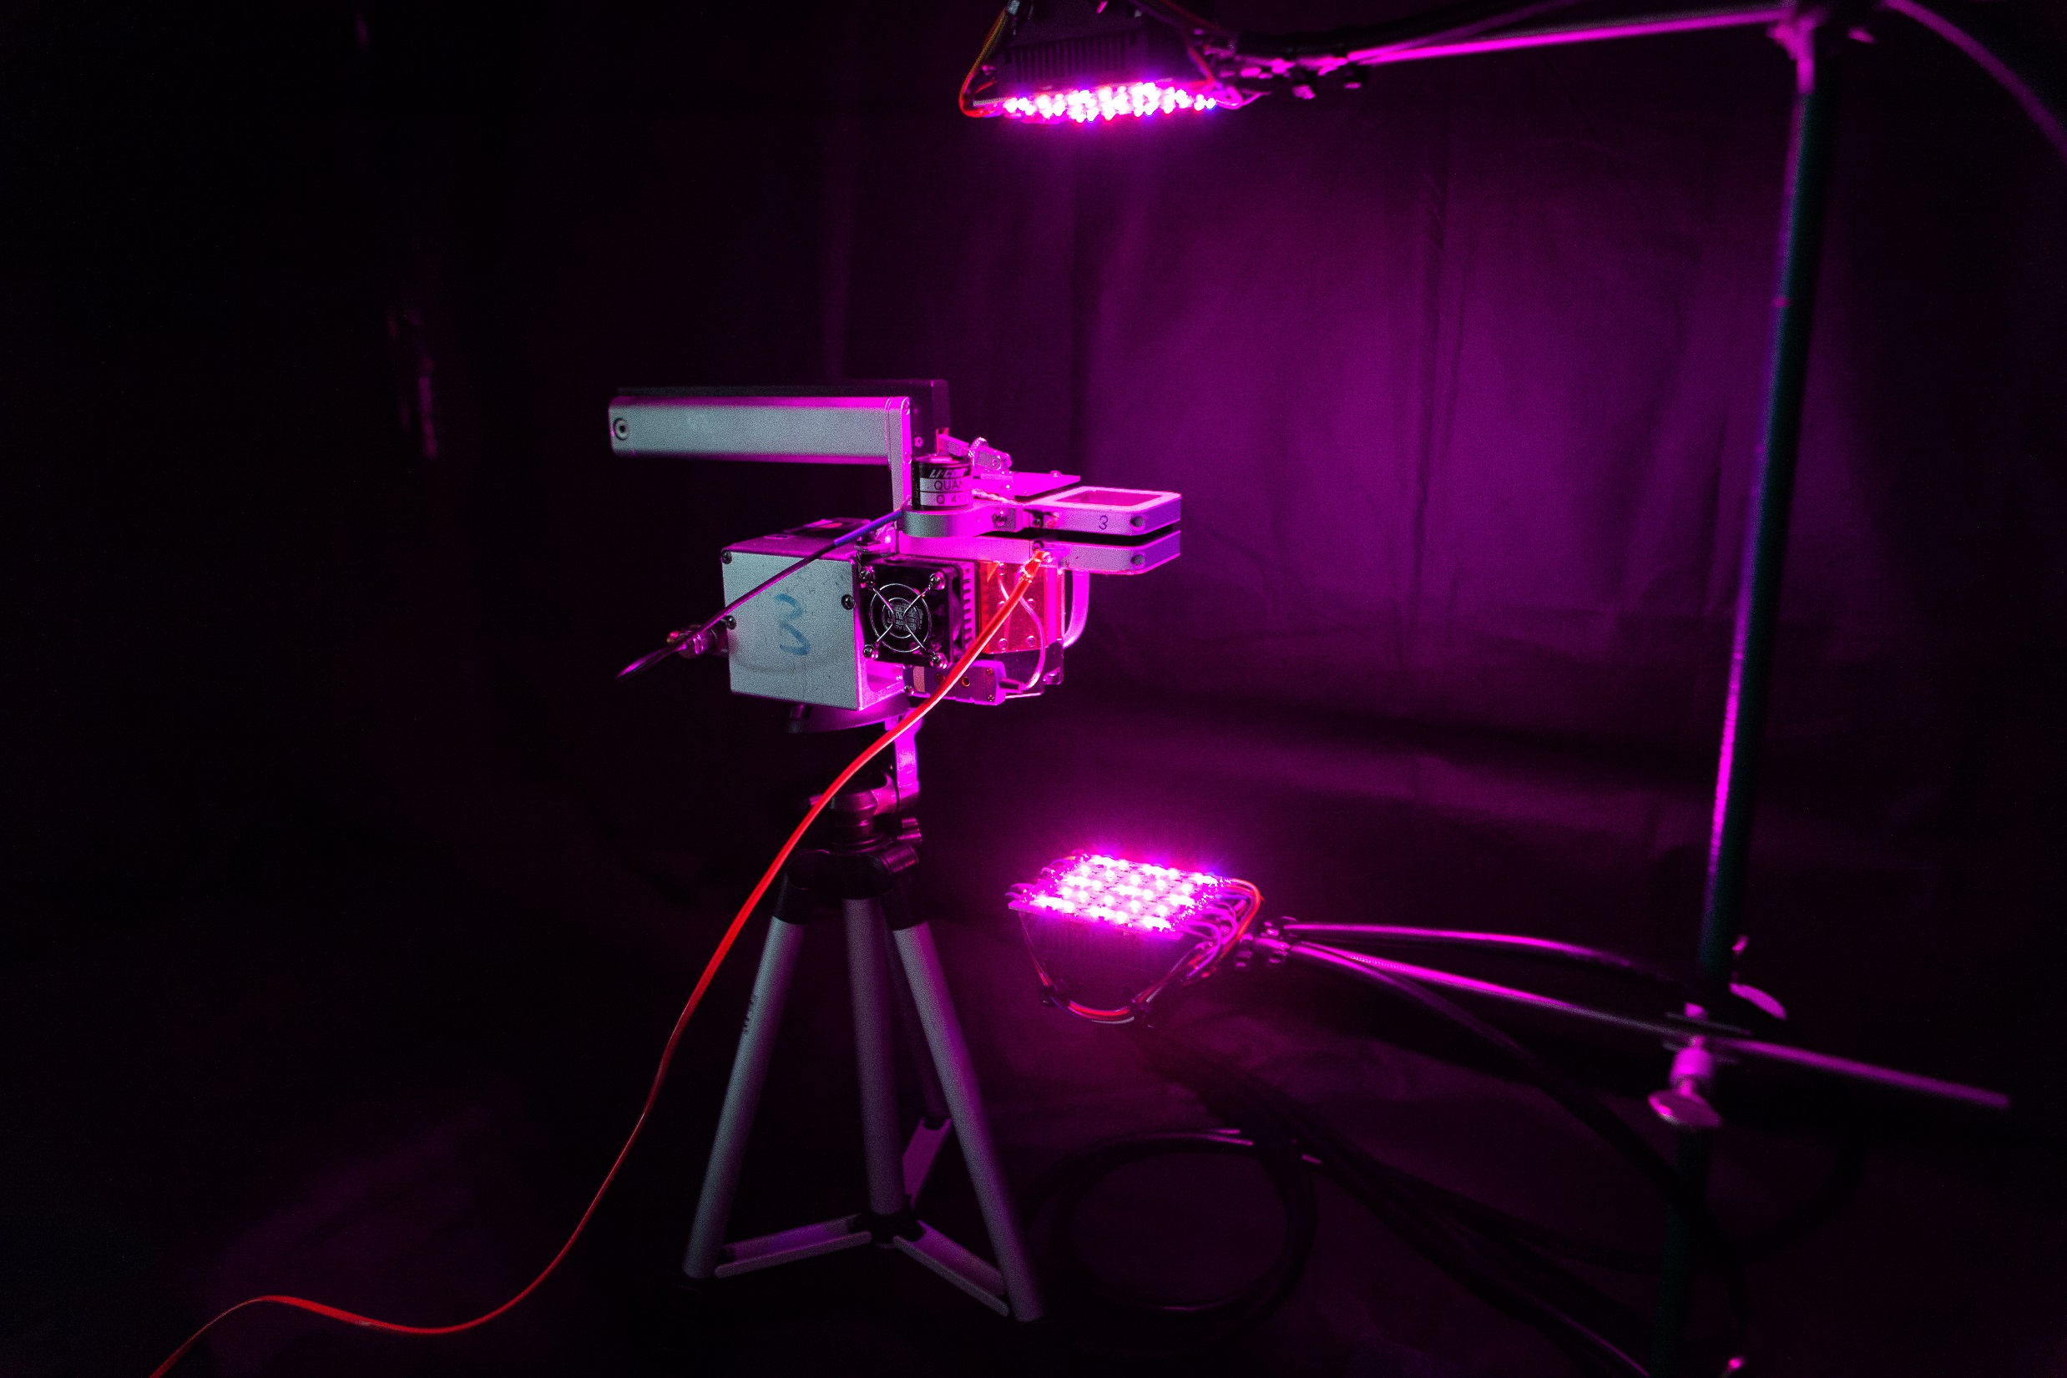
Gas exchange measurements

Slide 37

Gas exchange measurements
Light response curves
CO₂ dose response curves
Dark-adapted fluorescence

Slide 38
Don’t get confused
Treatment effect:
acclimation to light direction
Measurement effect:
instantaneous leaf side effect

Slide 39

Don’t get confused
Growth treatment
Treatment effect:
acclimation to light direction
Measurement effect:
instantaneous leaf side effect

Slide 40
Final datasets
For 12 individual plants we have:
Three datasets for light response curves:
LRC1;
LRC2; and
LRC2-F.
Two datasets for ACI curves:
ACI1; and
ACI2.
The 1 means that Oxygen was at atmospheric levels (21%).
The 2 means grown in 2% Oxygen.

Slide 41
Attempt 3
Now we have the data.
Next we want to try Sharkey’s model.
Try Yin & Struik’s model.

Slide 42
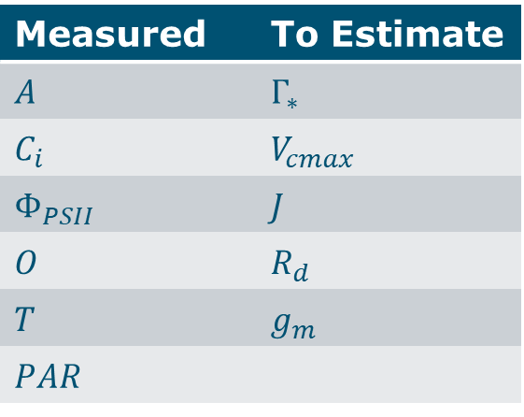
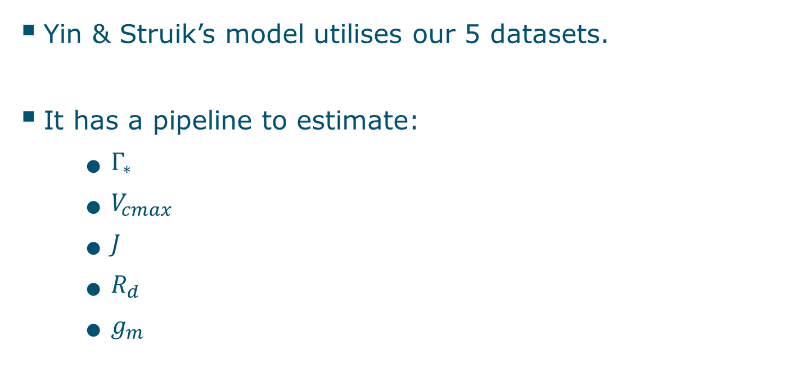
Attempt 3 (ii)
Yin & Struik’s model utilises our 5 datasets.
It has a pipeline to estimate:
$Γ_{∗}$
$V_{cmax}$
$J$
$R_{d}$
$g_{m}$
Measured | To Estimate
𝐴 | $Γ_{∗}$
$C_{i}$ | $V_{cmax}$
$Φ_{PSII}$ | $J$
𝑂 | $R_{d}$
𝑇 | $$g_{m}$$
𝑃𝐴𝑅

Slide 43
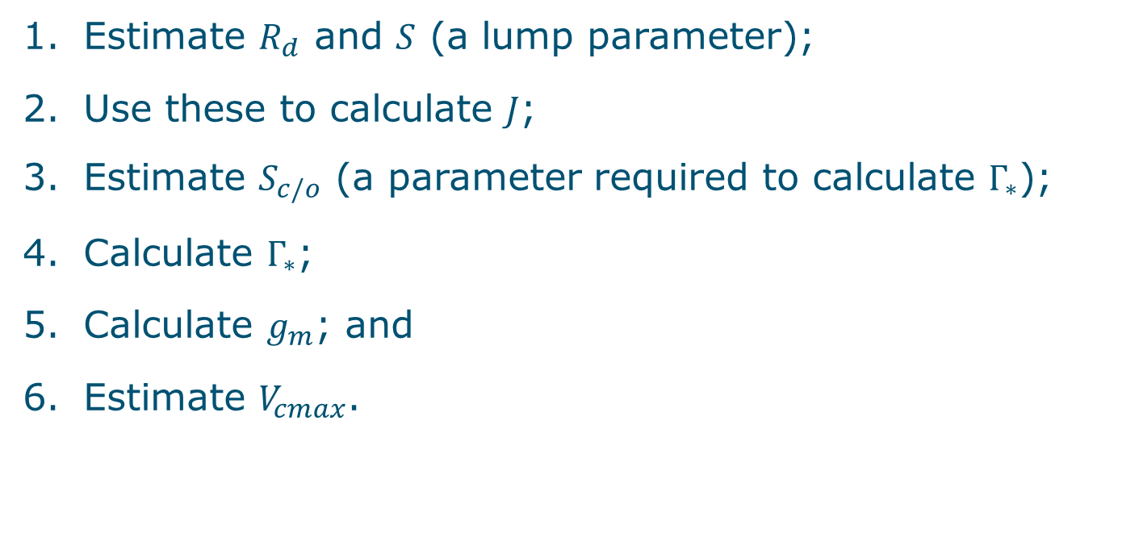
Yin & Struik pipeline
Estimate $R_{d}$ and $S$ (a lump parameter);
Use these to calculate $J$;
Estimate $S_{c/o}$ (a parameter required to calculate $Γ_{∗}$);
Calculate $Γ_{∗}$;
Calculate $g_{m}$; and
Estimate $V_{cmax}$.

Slide 44

Novelty
Use linear mixed effects models in estimating $R_{d}$, $S$ and $S_{c/o}$ and non-linear mixed effects models in estimating $V_{cmax}$.
Capture variance due to individual differences.
Can use unique photosynthetic parameters for each individual.

Slide 45



Step 1: $R_{d}$
Use the LRC2 and LRC2-F datasets.
A linear model regressing net photosynthesis on $\frac{1}{4}I Φ_{PSII}$
Interpretation:
Intercept is $R_{d}$.
Slope is $S$.

Slide 46

Step 1 (ii)

Slide 47

Step 1 (iii)

Slide 48



Step 2: $J$
In this model:
$$J=S×I ×Φ_{PSII}$$

Slide 49



Step 3: $S_{c/o}$
Use the linear part of the ACI1 and ACI2 datasets.

Slide 50

Step 3 (ii)
Using this combination of high and low Oxygen datasets, calculate:
$$S_{c/o}=\frac{O_{h}−O_{l}}{2(\frac{\left(A_{l}+R_{d}\right)}{b_{l} }−\frac{A_{h}+R_{d}}{b_{h}}−\left(C_{il}−C_{ih}\right))}$$
$b_{l},b_{h}$ are the slopes for the regression of $A$ on $C_{i}$ for the low Oxygen and high Oxygen datasets respectively.

Slide 51


Step 4: $Γ_{∗}$
Calculate:
$$Γ_{∗}=\frac{1}{2}\frac{O}{S_{c/o}}$$

Slide 52


Step 5: $g_{m}$
Calculate:
$$g_{m}=\frac{A}{C_{i} − Γ_{∗}\frac{J +4 \left(A +R_{d}\right)}{J−8 (A+R_{d})}}$$
Expect an average value close to 0.16.
Use this to convert from $C_{i}$ to $C_{c}$:
$$C_{c}=C_{i}−\frac{A}{g_{m}}$$

Slide 53

Step 6: $V_{cmax}$
Combining the results from all the previous steps use the FvCB model.

Slide 54
Step 6 (ii)
Known.
Unknown.

Slide 55

Step 6 (iii)
Estimate $V_{cmax}$ using the $nlme$ function in R with FvCB as the formula.
Estimate for SIDE and TREATMENT fixed effects.
Plant ID as random effects.

Slide 56
Step 6 (iv)
Unfortunately we have not had any of the NLME models converge.

Slide 57
Conclusions
Photosynthesis is a developing field.
A lack of agreement on best practice makes analysis difficult.
There is room for statisticians to have an impact.

Slide 58

Thank you for your attention

